Slide 1
How do we define a population?
Required reading: Preface pgs xix-xxii in Vandermeer, JH and Goldberg, DE. 2013. Population Ecology: First Principles (2nd Edition).

Slide 2
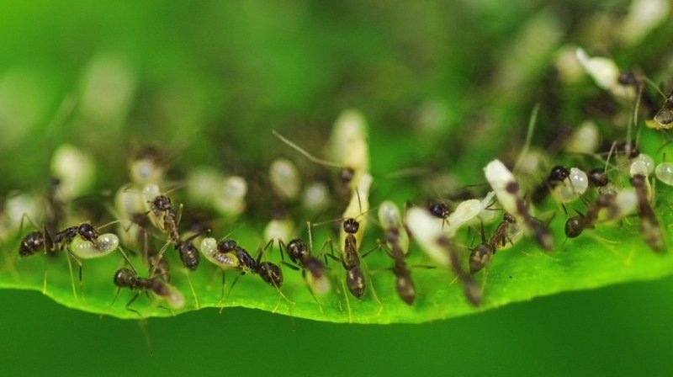
Photo credit: www.npr.org: Gurinder Osan/AP
Notes:
Stop and recap. 1) A population is a group of interbreeding individuals that overlap in time and space.

Slide 3
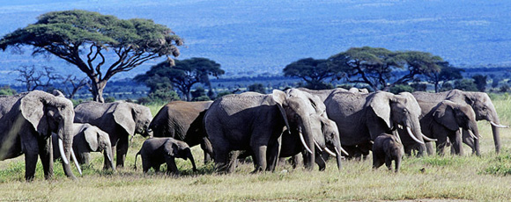
Photo credit: wwf.worldwildlife.org

Slide 4
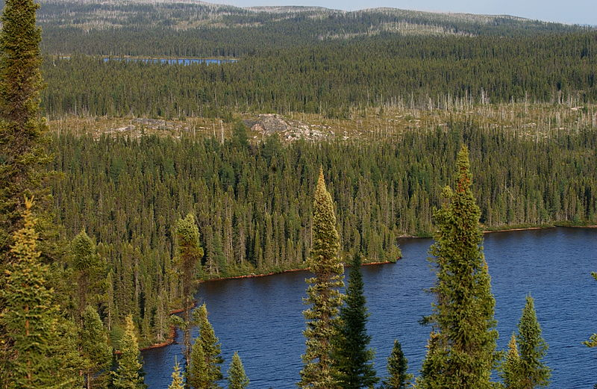
Photo credit: peupleloup
Notes:
Taiga in Quebec, dominated by Black spruce.

Slide 5
What is a population?

Slide 6
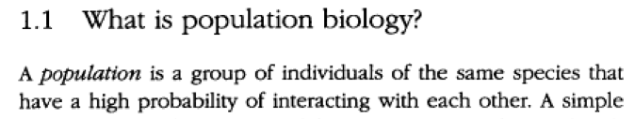
population
A group of interbreeding individuals that exist together in time and space.
Levin, S. 2013. Princeton Guide to Ecology – Population Genetics and Ecology.
Hastings, A. 1996. Population Biology: Concepts and Models.

Slide 7
Why does it matter?

Slide 8
A population is simply a collection of individuals, but the idea of a population is considerably more complex
What size limits should be placed on a fishery?
Size distribution
Reproduction and survivorship as a function of size
When is it best to take action on the emergence of an agricultural pest species?
the distribution of individuals in various life stages
Vandermeer, JH and Goldberg, DE. 2013. Population Ecology: First Principles (2nd Edition).

Slide 9
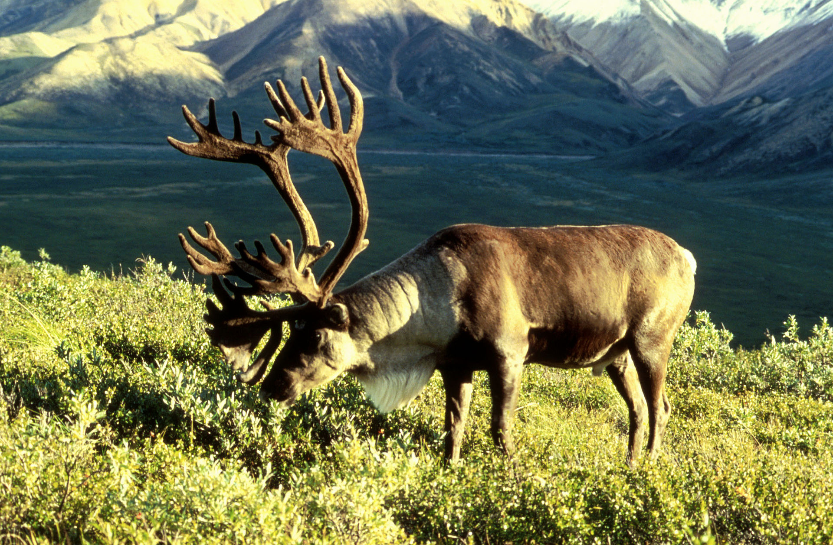
Notes:
Migratory caribou

Slide 10
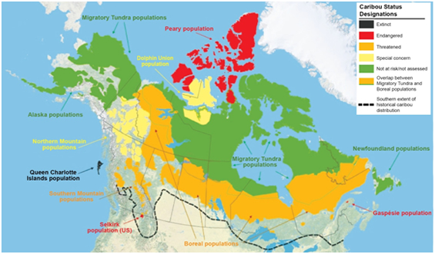

biodivcanada.ca: Technical thematic report No. 10 – Northern caribou population trends in Canada
Notes:
COSEWIC is an active link

Slide 11
COSEWIC advises the Canadian government on species to be listed on the List of Wildlife Species at Risk protected by the Species at Risk Act (SARA)
For those species listed it is illegal to:
kill, harm, harass, capture or take an individual;
possess, collect, buy, sell or trade an individual or any part of an individual; and
damage or destroy the residence of one or more individuals.

Slide 12
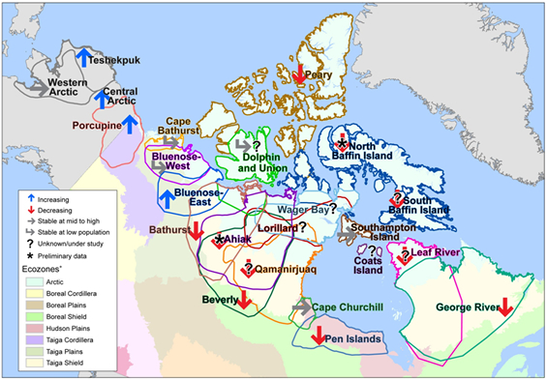
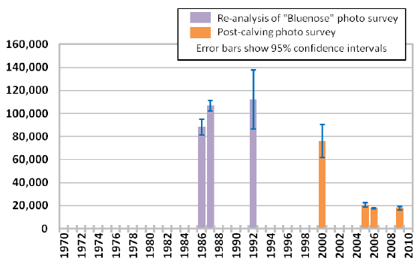
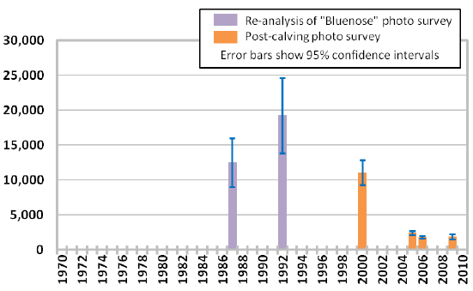
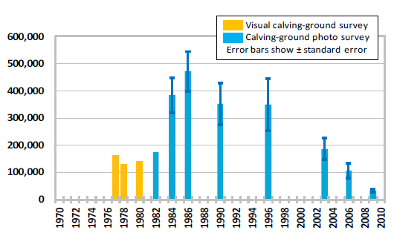
Figure 10. Bluenose-West Caribou Herd population estimates.
Figure 3. Ranges and recent trends of northern caribou populations in Canada.
Figure 11. Cape Bathurst Caribou Herd population estimates.
Figure 7. Caribou Herd population estimates.
Notes:
What if all the populations where just considered one population? Cape Bathhurst and Bluenose West had been considered the same population

Slide 13
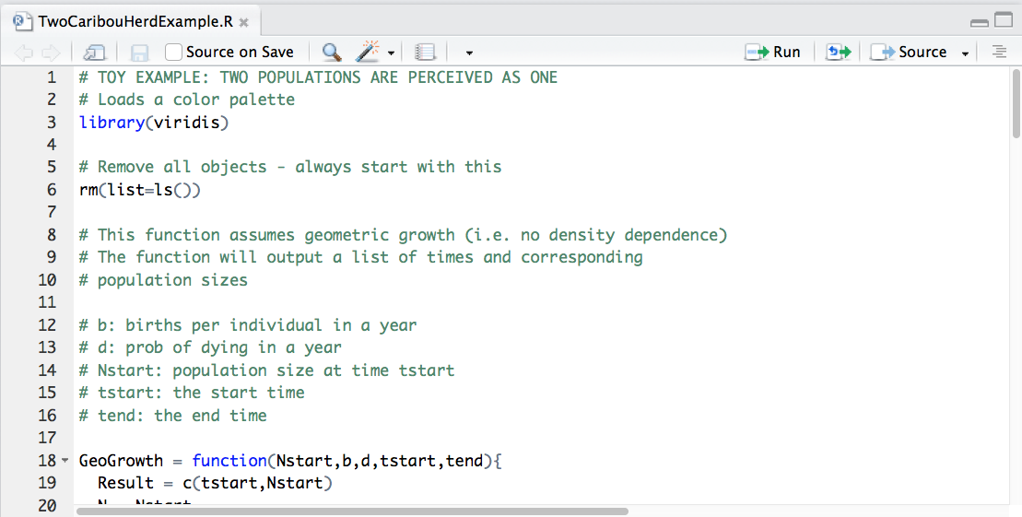

Slide 14
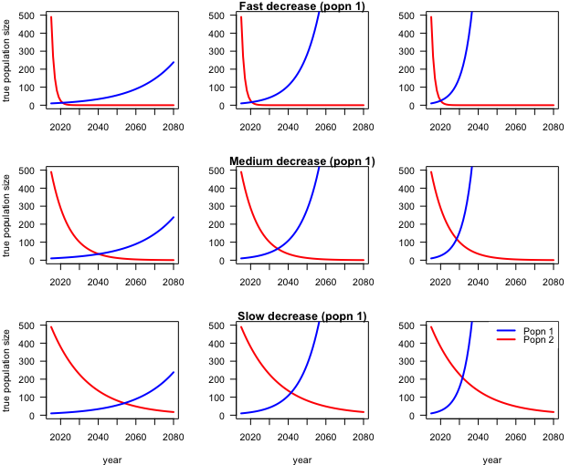

Slide 15
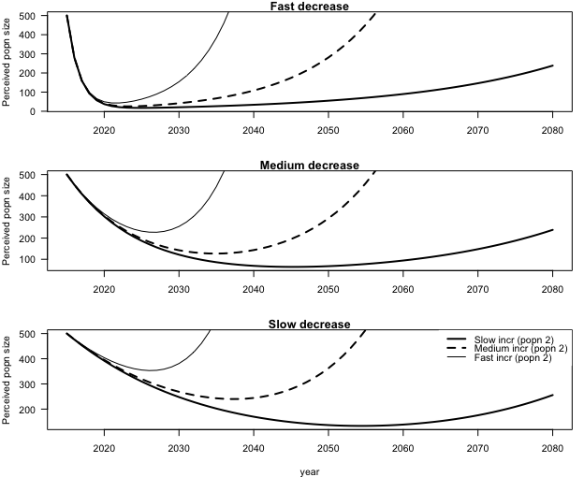

Slide 16
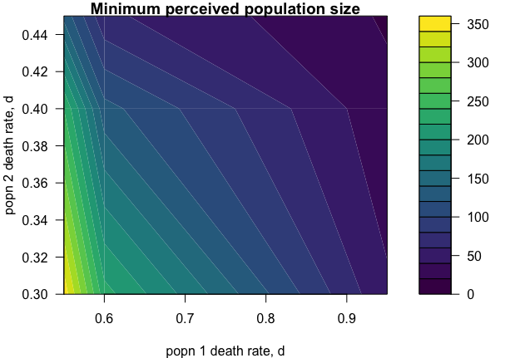

Slide 17
What are some limitations of the “TwoCaribouHerdExample.R” toy example?
Notes:
Geometric growth, increasing population starts smaller, large differences in mortality, not spatially explicit, no stochasticity

Slide 18
Why, in practice, is it difficult to apply the definition of population?
Notes:
Not spatially delineated. Different breeding and wintering ranges. One or two animals might move between a herd – is that enough/too many?

Slide 19
Summary
A population is a group of interbreeding individuals that overlap in space and time.
Other definitions are also correct. The key feature of a definition of a population is that individuals “able” to reproduce with each other.
Of interest is how the population might change
The definition of a population is important for conservation biology
The definition of a population can be difficult to apply. For specific studies, additional details on how the definition has been applied may be necessary.

